Slide 1
Plant Science: Its Place in Biology
Roundtable
Organiser and chair: Sabina Leonelli, University of Exeter
Panel:
Jean-Francois Briat, Centre National de la Recherche Scientifique
Berris Charnley, Griffith Law School
Bertrand Muller, Institut de Biologie Intégrative des Plantes
Staffan Mueller-Wille, University of Exeter
Francisco Vergara-Silva, Universidad Nacional Autónoma de México
Betty Smocovitis, University of Florida
Selim Louafi, International Center for Agricultural Research for Development

Slide 2
Why this roundtable?
Plant science curiously understudied in HPSSB – no wonder that few plant scientists are aware of us
Also generally regarded as less prestigious and relevant field than animal biology and biomedicine
This is a puzzling and problematic situation, given
Key role played by plant science in history of biology
Fundamental philosophical issues raised
Generalist and holistic nature of plant science research
Social, cultural and economic relevance
Potential value of collaborations between plant scientists and science scholars at this point in time (e.g. in evaluating how PS can respond to grand challenges, how ‘sustainability’ can be interpreted, how data and materials from basic and applied PS can be integrated..)

Slide 3
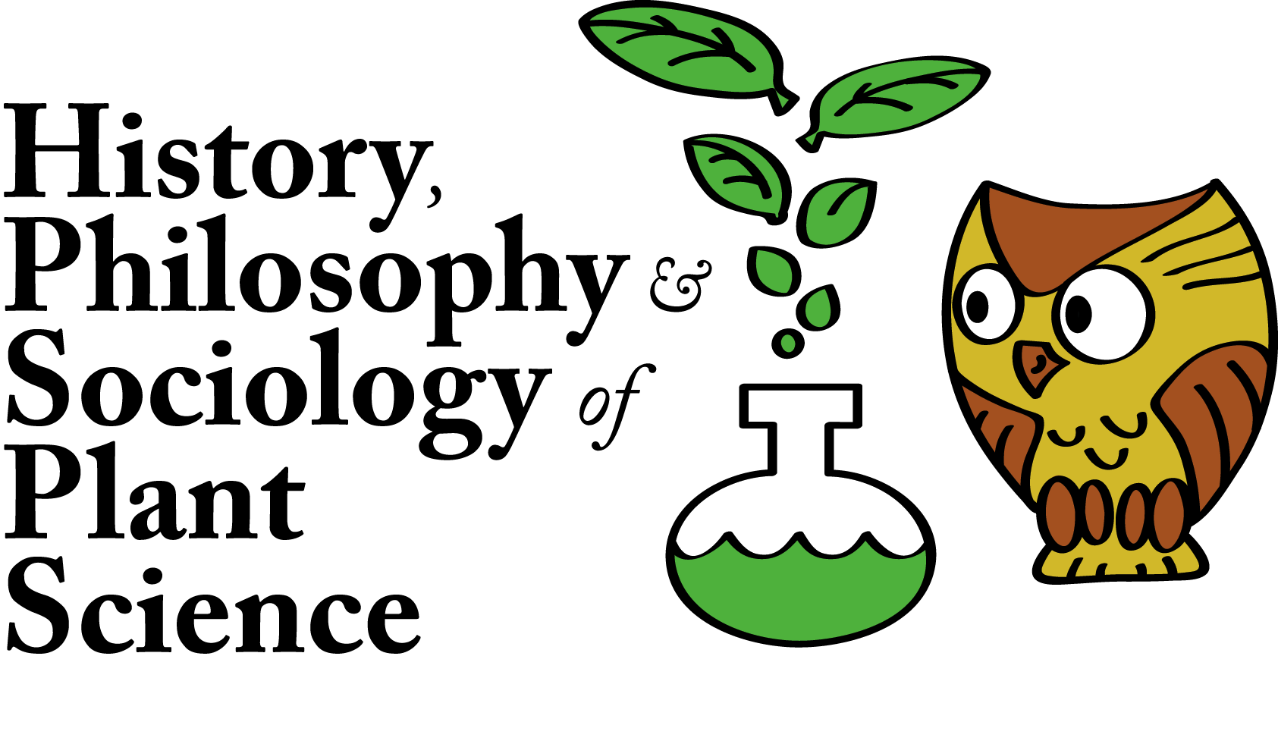
Steps forward
Commitment to share data and materials on history of plant science through online tools
Heightened awareness of when key research developments arise from work on plants
Networking among HPSSB folks (e.g. UK Network for the History, Philosophy and Sociology of Plant Science http://people.exeter.ac.uk/sl306/hpsps/)
Collaborations with plant scientists

Slide 4
Jean-François Briat
Research Director
Centre National de la Recherche Scientifique (CNRS)
Biochimie et Physiologie Moléculaire des Plantes
France

Slide 5
Berris Charnley
Research Fellow
ACIPA
Griffith University
Australia

Slide 6
Bertrand Muller
Directeur
Ecophysiologie des Plantes sous Stress Environnementaux (LEPSE),
UMR INRA-SUPAGRO, Institut de Biologie Intégrative des Plantes
France

Slide 7
Staffan Müller-Wille
Associate Director, Exeter Centre for the Study of the Life Sciences (Egenis)
Senior Lecturer, College of Humanities
University of Exeter
UK

Slide 8
Francisco Vergara-Silva
Laboratorio de Sistemática Molecular (Jardín Botánico),
Instituto de Biología, Universidad Nacional Autónoma de México
Mexico

Slide 9
Vassiliki Betty Smocovitis
Professor in History of Science
Departments of Biology and History
University of Florida
USA

Slide 10
Selim Louafi
Senior Research Fellow
Joint Unit of Research AGAP (Amélioration Génétique et Adaptation des Plantes)
CIRAD (International Center for Agricultural Research for Development)
France

Slide 11
Abstract
Plant science is too often a ‘forgotten’ field within the history, philosophy and social studies of science. This is puzzling, given its immense contributions to the history of genetics, ecology and cell biology, among other fields; the crucial role played by plant scientists in contemporary systems biology and data-intensive research; and the importance of ongoing plant research towards addressing the key social and economic challenges of our time, such as food security, bioenergy and climate change. Among the possible reasons for the relative invisibility of plants within biology are the difficult relations between ‘basic’ and ‘applied’ plant science (and particularly molecular approaches carried out in the lab versus field-based investigations closely aligned with agricultural practices); the scarcity of funding and media attention in comparison to biomedical research; and the lack of co-ordination between scholars interested in this field (the digital platform History, Philosophy and Sociology of Plant Science is trying to address this in the UK, though it lacks long-term funding). This session brings together plant scientists, philosophers and historians to identify and discuss past and current contributions of plant science to biology; reflect on the reasons for the relative lack of visibility of these contributions; and explore ways to deepen current understandings of the role of plant science in biology, and encourage public and scholarly interest in plants. The session will feature short addresses by panel members and an open discussion in which we hope many of our fellow ISHPSSB members will participate.

